Slide 1
Unit-12
Family planning

Slide 2
FP objectives , targets, indicators, strategies and achievement
The main thrust of the national family planning programme is to expand and sustain adequate quality family planning services to communities through the health service network such as hospitals, primary health care (PHC) centers, health posts(HP), sub health post(SHP), primary health care outreach clinics(PHC/ORC) and mobile voluntary surgical contraception(VSC) camps. The policy also aims to encourage public private partnership. Female community health volunteers(FCHV) are to be mobilized to promote condom distribution and re-supply of oral pills. Awarness on FP is to be increased through various IEC/BCC intervention as well as active involvement of FCHVs and mothers groups as envisaged by the revised national strategy for female community health volunteers program.

Slide 3
In this regard, family planning services are designed to provide a constellation of contraceptive methods/ services that reduce fertility, enhance maternal and neonatal health, child survival, and contribute to bringing about a balance in population growth and socio-economic development, resulting in an environment that will help the nepalese people improve their quality of life.

Slide 4
Objectives
Within the context of reproductive health, the main objectives of the family planning program are to assist individuals and couple to:
Space and/or limit their children.
Prevent unwanted pregnancies.
Improve their overall reproductive health.

Slide 5
Targets
Periodic and long- term targets for the family planning programs have been established as follows:
To reduce TFR to 2.5 children per woman by 2015.
To increase the contraceptive prevalance rate(CPR) to 67 percent by 2015.
(increase budget 7% each year on fp)

Slide 6
Strategies
In order to achieve the CPR and the TFR targets mentioned above, and reconizing the importance of spacing of births,the family planning program has been placing greater emphasis on promoting temporary methods of contraception. More specifically, the long term objective is to reduce the share of permanent sterilization in overall use of family planning methods.

Slide 7
The family planning program aims to provide a constellation of contraceptive services throughout the country. The strategy to achieve the family planning goals includes the following elements:
Periodic review of policy through national RH steering committee meetings.
Co- ordination of FP program and activities through RH co-ordination committee networks including family planning sub- committee.

Slide 8
institutionalization of policy/operational guidelines and clinical protocols to ensure maximum coverage and quality of family planning services.

Slide 9
Increasing knowledge and understanding of the benefits of delayed marriage, birth spacing, and well planned family norm across the country through integrated RH/IEC/BCC activities.
Increasing accessibility and availability of FP services through combination of static , outreach and referral services.

Slide 10
Establish FP service as a part of hospital service and strengthen institutionalized family planning services centres.
Expanding regular year- round and mobile VSC outreach services, and expanding IUCD services to PHC and HP, with special emphasis on through counseling and follow up services.
Linking FP program with essential health care service.

Slide 11
Providing non- clinical methods(condoms, pills, and injectables) through static and outreach service.
Training of service providers.

Slide 12
Improving the quality of care in accordance with the national medical standards for contraceptive services, with special atttention on counseling, infection prevention and management of side effects and complication.

Slide 13
Provide recanalization services in selected hospitals.
Establishing post-partum FP services in institutions with a significant caseload of deliveries.
Integrating family planning services with post abortion care and safe abortion care.
Identifying national requirements and ensuring adequate procurement of contraceptives and logistic supplies.

Slide 14
Promote wider use of health management information systems(HMIS) and health system research for better planning and program management.
Ensuring effective monitoring and supervision of FP programs.
Increasing free access to condom by having condom boxes at all health institutions and resupplying pills and distributing condom through FCHVs.

Slide 15
Main indicators
1. Total fertility rate(TFR)
Description
Expresses the average number of children a women will bear by the end of her reproductive life under prevailing fertility conditions. While data on TFR are not available from HMIS.
Nepal undertakes fertility or demographic and health surveys every five years, which provide an updated estimate of TFR.

Slide 16
Contraceptive prevalance rate (CPR)
Expresses the percentage of MWRA using any modern contraceptive device at a point of time.

Slide 17
Couple year-of protection
Couple year- of protection
The estimated protection provided by family planning (FP) services during a one-year period, based upon the volume of all contraceptives sold or distributed free of charge to clients during that period..

Slide 18
MethodCYP Per Unit
Oral Contraceptives15 cycles per CYP
Condoms (male and female)120 units per CYPMonthly
Depo Provera Injectable4 doses (ml) per cyp
Noristerat Injectable 6 doses per cyp
Cyclofem Monthly Injectable13 doses per CYPC etc…

Slide 19
Method- specific new acceptors as a percent of MWRA.
Expresses the percentage of MWRA using specific FP methods for the first time in specific period.

Slide 20
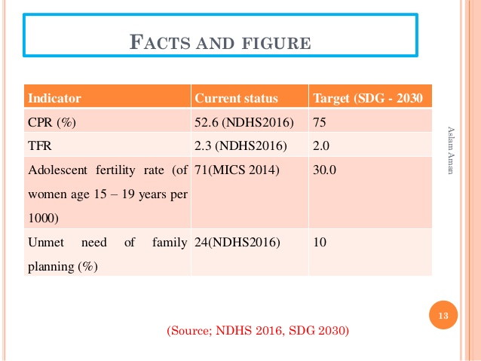

Slide 21
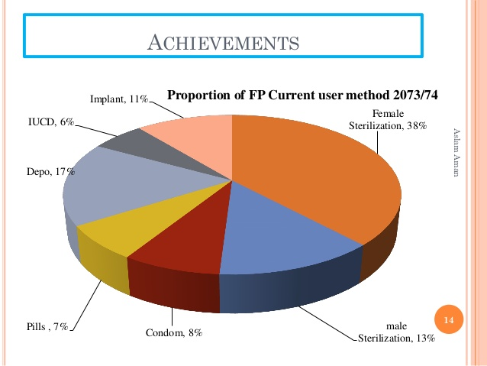

Slide 22
Achievement 2066/2067
Contraceptive prevalance Rate(modern)-43.73%
Condom(CPR method mix)-3.07%
Pills- 3.01%
Depo provera-8.18%
IUCD -1.75%
Norplant -1.82%
Sterilization-25.90%

Slide 23
Role and responsibilities of a nurse in management of family planning service
Roles
Health educator
Counselor
Health care provider
Advisor
Facilitator
Supervisor
Administrator
Evaluator
Coordinator
Researcher

Slide 24
Responsibilities
Encourage and support the couple if they desire to have a small family.
Educate/ teach the method of family planning to an individual, couple and groups. By using IEC materials of FP.
Counseling the clients and then help the client to get rid of their fear, doubt, concerns by giving clear information and clearing up misunderstandinsg and removing misconception.

Slide 25
Help the client to choose the one which suits her and her family by providing the accurate information about the FP devices.
Support and provide warmth to the couple who need family planning services.

Slide 26
Prepare the physical set up of family planning clinic.
-management of clinical set up.
-arrangement of an examination room and waiting room.
-supervise the cleaning of the rooms.
Preparation and sterilization of equipments and suppplies.

Slide 27
Maintain the principle infection preventing during all procedure of FP.
Arrrange and provide the training to the staffs about new concept and methods of FP as well as infection prevention.
Preparation of the FP client for:
Counseling
sterilization

Slide 28
Assist the surgeon while performing surgical procedure e.g laparoscopy, minilap and vasectomy.
Supervise and guide to junior staffs, students and sub-ordinate.
Provide postoperative care as well as give advice for the follow- up visit and medicines.
Refer the clients at appropriate facility for family planning if not available in this institute. The nurse should be aware of all available services, so that she can refer the potential couple/ individual to nearby facilities for further information and service.

Slide 29
Organize and involve the mobile of FP.
Conduct family planning program and maintain accurate record and report.

Slide 30
Family planning
“According to WHO (expert committee, 1971); it is way of thinking and living that is adopted voluntarily, upon the basis of knowledge, attiudes and responsible decisions by individuals and couples, in order to promote the health and welfare of the family group and thus contribute effectively to the social development of the country.”

Slide 31
It is the conscious effort of couples to regulate the number and spacing of births through artificial and / or natural methods of contraception.

Slide 32
Purposes of family planning
To avoid unwanted births.
To bring about wanted births.
To regulate the interval between pregnancy.
To control the time at which births occur in relation to the ages of the parents.
To determine the numbers of children in the family.

Slide 33
To provide treatment in case of infertility in the couple.
To improve and promote the health status of mothers as well as whole family.
To decrease the maternal and child mortality and morbidity rate.

Slide 34
Scope of family planning
The proper spacing and limitation of births.
Advice on sterility.
Education for parenthood.
Sex education.
Screening for pathological conditions related to the reproductive system.
Genetic counseling.
Premarital consultation and examination
Carrying out pregnancy tests

Slide 35
Marriage counseling.
Services for unmarried mothers
Teaching home economics and nutrition.
Providing adoption services.

Slide 36
Health aspect of family planning
Women’s health-FP
Fetus’s health
Infant and child health:FP
Women’s health
The avoidance of unwanted pregnancies
Limiting the number of birth and proper spacing.

Slide 37
Population problem and need of FP in nepal
Population problem is the major problem of the country. The reasons behind of the problems are:
Population explosion
Excessive growth rate
Social and economical reason.
Health risk

Slide 38
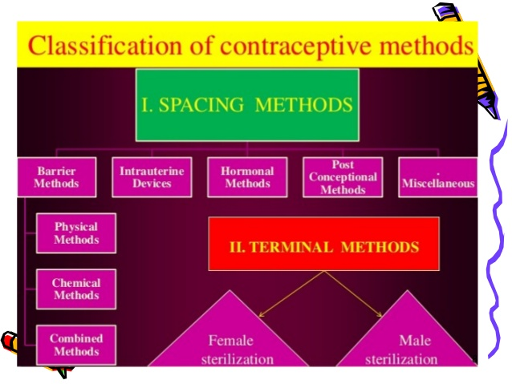

Slide 39
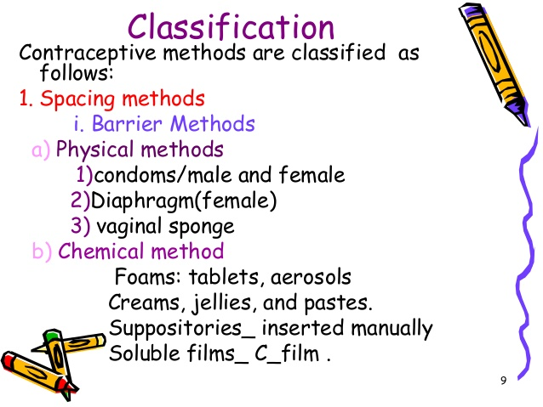

Slide 40
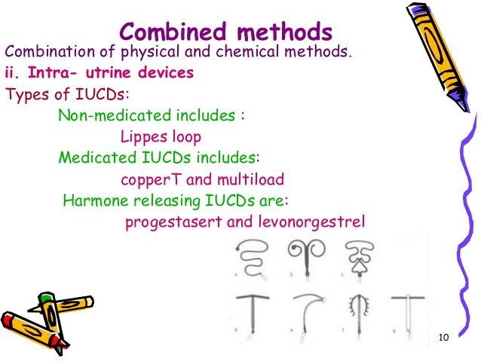

Slide 41
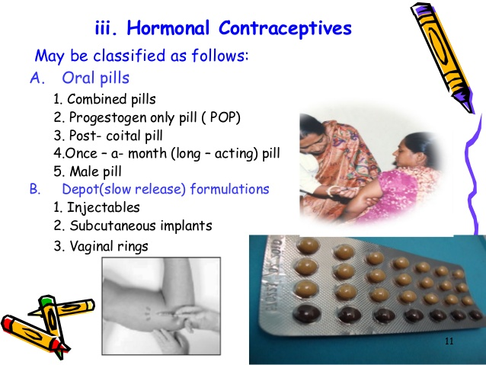

Slide 42
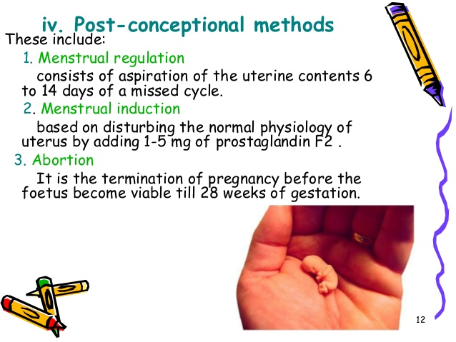

Slide 43
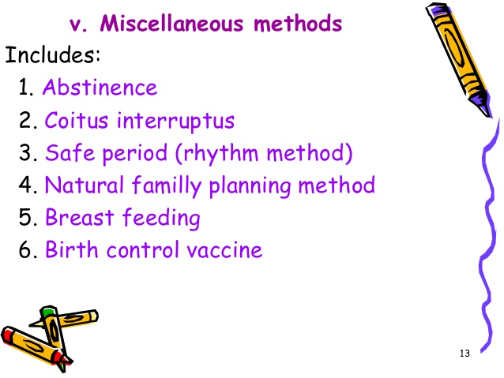

Slide 44
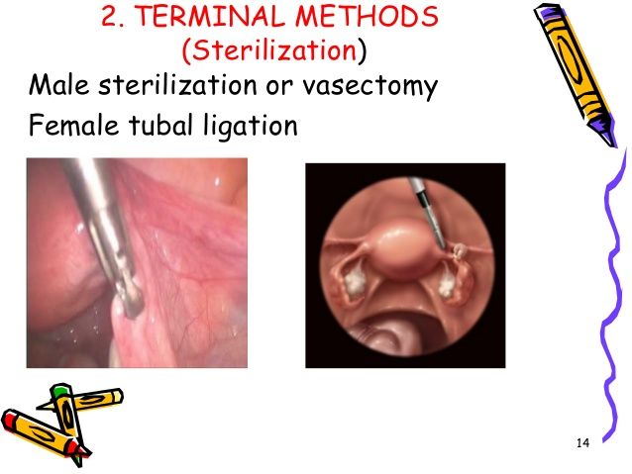

Slide 45
Family planning counseling
Counseling:
Counseling is face to face, unbiased or objective, two way communication between service providers and the clients.

Slide 46
Gather approach on FP
G- Greet the client respectfully.
A- Ask them about their family planning needs.
T- Tell them about different contraceptive options and methods.
H - Help them to make decisions about choices of methods.
E - Explain and demonstrate how to use the methods.
R- Return/refer; schedule and carry out a return visit and follow up.

Slide 47
Abhibadan process on nepali
A- greet(namaskar garne..)
Bhi (bhinna nathani sodhpuchha garne)
Ba (badha hatauna suchana upalabdha garaune)
Da( dutta chitta bhai sahayog garne)
Na(namaskar gardai puna aauna anurodh garne)

Slide 48
What is informed choice
All family planning clients have
right to informed choice:
Opportunity to freely choose
among options
Based on access to
Complete, accurate information
about all appropriate, available
options

Slide 49
Fp client’s have right to freely choose
Whether to:
Have children, and how many to have
Use FP or not
Be tested for STIs/ HIV
Use condoms
Have one or more sexual partners
Talk with partner about condoms or FP
Reveal their HIV status

Slide 50
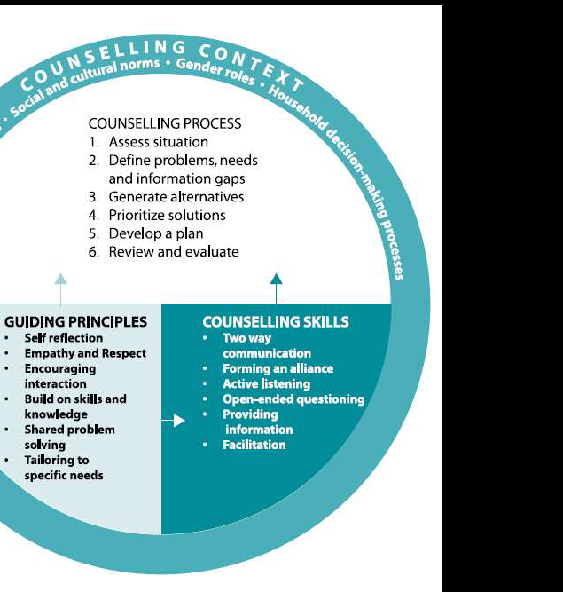

Slide 51
Elements of good counselling
Focus on the woman's needs and
knowledge
Assess the context of the problem with
the woman
Actively listen and learn from her
Engage in interactive discussion
Utilize skilled ways of asking questions
Explore situations and beliefs
Do not be judgmental
Build trust

Slide 52
Explore options together
Facilitate problem-solving
Make a plan of action together
Encourage and reinforce actions
Evaluate together your plan of action

Slide 53
Counselling is not….
Solving a client’s problems
Telling a client what to do or making
decisions for client
Judging, blaming, or lecturing a client
Interrogating a client
Imposing your beliefs

Slide 54
Pressuring a client to use a specific method
Lying to or misleading a client

Slide 55
Beliefs and attitude
Be aware of your beliefs and attitudes
Clients may not return if they feel judged
or pushed
Remain neutral and nonjudgmental
Respect the rights of your clients
Practice helps

Slide 56
Stages of FP Counseling
Establish rapport and assess client’s
needs and concerns
Provide information to address
client’s needs and concerns
Help client make an informed
decision or address a problem
Help carry out client’s decision

Slide 57
Assess Client’s Needs, Concerns
Greet client appropriately
Ensure privacy, confidentiality, and client comfort
Ask about reason for visit
Ask about partner(s), home life, family, health,
sexual behavior, HIV status
Ask about plans to have children, desire for FP
Explore STI risk and what client does to avoid
STI’s

Slide 58
Provide Information to Address Client’s Needs and Concerns
Inform client when needs or concerns are
beyond health worker capability.
Advise on how to prevent STIs.
Advise on how to have a healthy pregnancy (if
client wants to become pregnant)

Slide 59
Explain benefits of FP and healthy spacing
If client wants FP, help client identify methods
suited to her needs.
Give information on methods of interest
Respond to other client questions or concerns

Slide 60
Why Clients Choose Methods
Effectiveness
How long client wants protection from pregnancy.
Ease of use
Health benefits and possible side effects
Safety

Slide 61
Help Client Make Informed Decision
Ask client if she or he has any questions
about methods you discussed
Ask client to choose a method
Use pregnancy checklist or method
screening checklist to determine if client
can use method
Agree on decision or plan in partnership
with client

Slide 62
Help Carry Out Client’s Decision
Role-play or rehearse negotiation skills
Give FP method and condoms, if needed
Explain/ demonstrate correct use
Ask client to explain/ demonstrate, reinforce
understanding or correct demonstration
Remind client about side effects, reasons to return
Arrange follow-up, resupply, or referral, as needed

